Slide 1
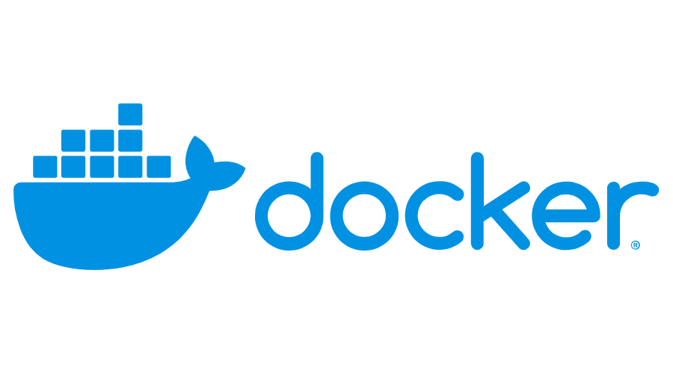
Domain – Networking
Created by :Rajagopal K
670334

Slide 2
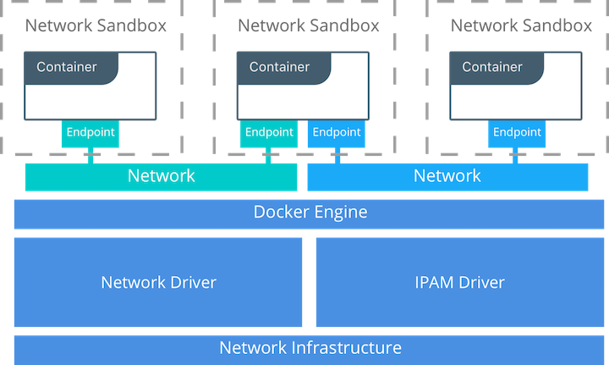
Container Networking Model
The Docker networking architecture is built on a set of interfaces called the Container Networking Model (CNM). The philosophy of CNM is to provide application portability across diverse infrastructures. This model strikes a balance to achieve application portability and also takes advantage of special features and capabilities of the infrastructure.

Slide 3
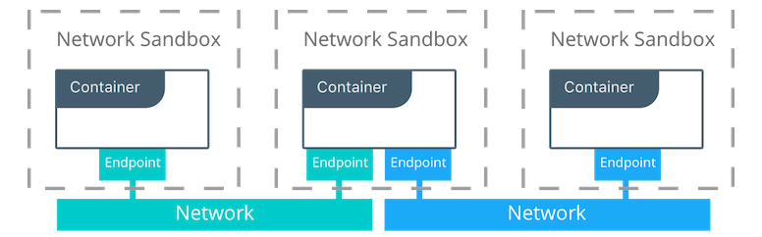
CNM Constructs :
There are several high-level constructs in the CNM. They are all OS and infrastructure agnostic so that applications can have a uniform experience no matter the infrastructure stack.
Sandbox — A Sandbox contains the configuration of a container's network stack. This includes management of the container's interfaces, routing table, and DNS settings. An implementation of a Sandbox could be a Linux Network Namespace, a FreeBSD Jail, or other similar concept. A Sandbox may contain many endpoints from multiple networks.
Endpoint — An Endpoint joins a Sandbox to a Network. The Endpoint construct exists so the actual connection to the network can be abstracted away from the application. This helps maintain portability so that a service can use different types of network drivers without being concerned with how it's connected to that network.
Network — The CNM does not specify a Network in terms of the OSI model. An implementation of a Network could be a Linux bridge, a VLAN, etc. A Network is a collection of endpoints that have connectivity between them. Endpoints that are not connected to a network do not have connectivity on a network.

Slide 4
Network Drivers :
Docker Network Drivers provide the actual implementation that makes networks work. They are pluggable so that different drivers can be used and interchanged easily to support different use cases. Multiple network drivers can be used on a given Docker Engine or Cluster concurrently, but each Docker network is only instantiated through a single network driver.
Types of Network Drivers :
Native Network Drivers
Remote Network Drivers
IPAM Drivers :
Docker has a native IP Address Management Driver that provides default subnets or IP addresses for networks and endpoints if they are not specified. IP addressing can also be manually assigned through network, container, and service create commands. Remote IPAM drivers also exist and provide integration to existing IPAM tools.

Slide 5
Docker Native Network Drivers :
The Docker native network drivers are part of Docker Engine and don't require any extra modules. They are invoked and used through standard docker network commands. The following native network drivers exist.
Host
Bridge
Overlay
MACVLAN
None
Network Scope :
The network scope is the domain of the driver which can be the local or swarm scope. Local scope drivers provide connectivity and network services (such as DNS or IPAM) within the scope of the host. Swarm scope drivers provide connectivity and network services across a swarm cluster. Swarm scope networks have the same network ID across the entire cluster while local scope networks have a unique network ID on each host.
Local
Swarm

Slide 6
Bridge Network :
In terms of networking, a bridge network is a Link Layer device which forwards traffic between network segments.
In terms of Docker, a bridge network uses a software bridge which allows containers connected to the same bridge network to communicate, while providing isolation from containers which are not connected to that bridge network.
The Docker bridge driver automatically installs rules in the host machine so that containers on different bridge networks cannot communicate directly with each other.
Types of Bridge Networks :
Default bridge network
User defined bridge network
Eg:
docker network create -d bridge mybridge
docker run -d --net mybridge --name db redis

Slide 7
Overlay Network :
The overlay network driver creates a distributed network among multiple Docker daemon hosts. This network sits on top of the host-specific networks, allowing containers connected to it to communicate securely.
When you initialize a swarm or join a Docker host to an existing swarm, two new networks are created on that Docker host:
an overlay network called ingress, which handles control and data traffic related to swarm services. When you create a swarm service and do not connect it to a user-defined overlay network, it connects to the ingress network by default.
a bridge network called docker_gwbridge, which connects the individual Docker daemon to the other daemons participating in the swarm.
Prerequisites for Overlay Network :
TCP port 2377 for cluster management communications
TCP and UDP port 7946 for communication among nodes
UDP port 4789 for overlay network traffic

Slide 8
Docker Network commands:
docker network connect | Connect a container to a network
docker network create | Create a network
docker network disconnect | Disconnect a container from a network
docker network inspect | Display detailed information on one or more networks
docker network ls | List networks
docker network prune | Remove all unused networks
docker network rm | Remove one or more networks

Slide 9
docker network create :
Creates a new network. The DRIVER accepts bridge or overlay which are the built-in network drivers.
If you don’t specify the --driver option, the command automatically creates a bridge network for you.
Eg:
docker network create -d bridge my-bridge-network
docker network connect :
Connects a container to a network. You can connect a container by name or by ID.
Once connected, the container can communicate with other containers in the same network.
Eg:
docker network connect my-bridge-network container1
docker network disconnect :
Disconnects a container from a network.
The container must be running to disconnect it from the network.
Eg:
docker network disconnect my-bridge-network container1

Slide 10
docker port:
List port mappings or a specific mapping for the container.
Eg:
docker port test
7890/tcp -> 0.0.0.0:4321
9876/tcp -> 0.0.0.0:1234
Network driver summary :
User-defined bridge networks are best when you need multiple containers to communicate on the same Docker host.
Host networks are best when the network stack should not be isolated from the Docker host, but you want other aspects of the container to be isolated.
Overlay networks are best when you need containers running on different Docker hosts to communicate, or when multiple applications work together using swarm services.
Macvlan networks are best when you are migrating from a VM setup or need your containers to look like physical hosts on your network, each with a unique MAC address.
Third-party network plugins allow you to integrate Docker with specialized network stacks.

Slide 11
REFERENCE LINKS
Create a Docker bridge network for a developer to use for their containers
Troubleshoot container and engine logs to understand a connectivity issue between containers
Publish a port so that an application is accessible externally
Identify which IP and port a container is externally accessible on
Describe the different types and use cases for the built-in network drivers
Understand the Container Network Model and how it interfaces with the Docker engine and network and IPAM drivers
Configure Docker to use external DNS
Use Docker to load balance HTTP HTTPs traffic to an application (Configure L7 load balancing with Docker EE)
Understand and describe the types of traffic that flow between the Docker engine registry and UCP controllers
Deploy a service on a Docker overlay network
Describe the difference between host and ingress port publishing mode

Slide 12
THANK YOU

